Slide 1
Codebasics Virtual Internship
Presentation on
‘Wavecon Telecom Analysis’
By : Poireiton Loukrakpam

Slide 2
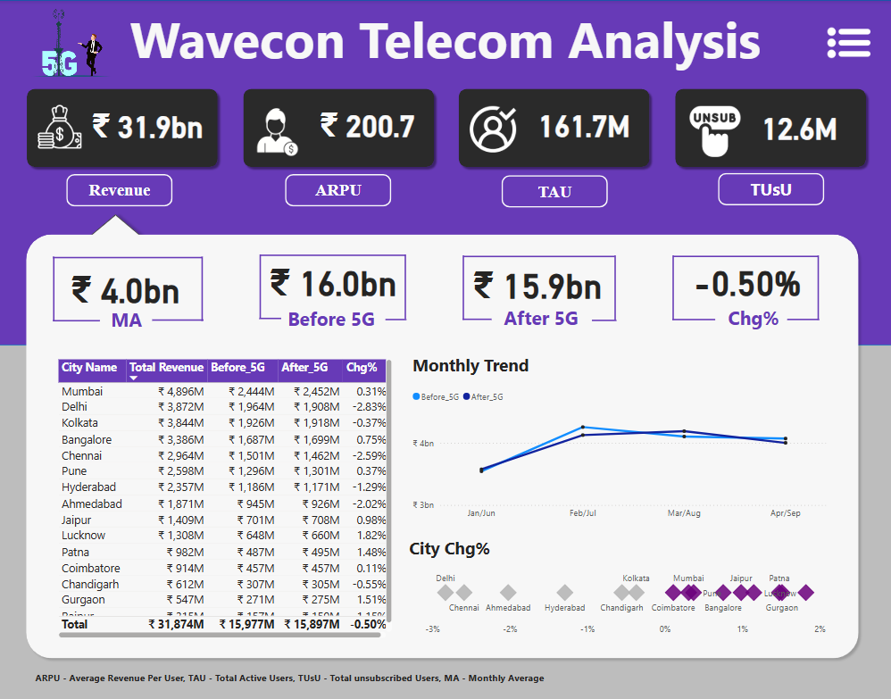

Slide 3
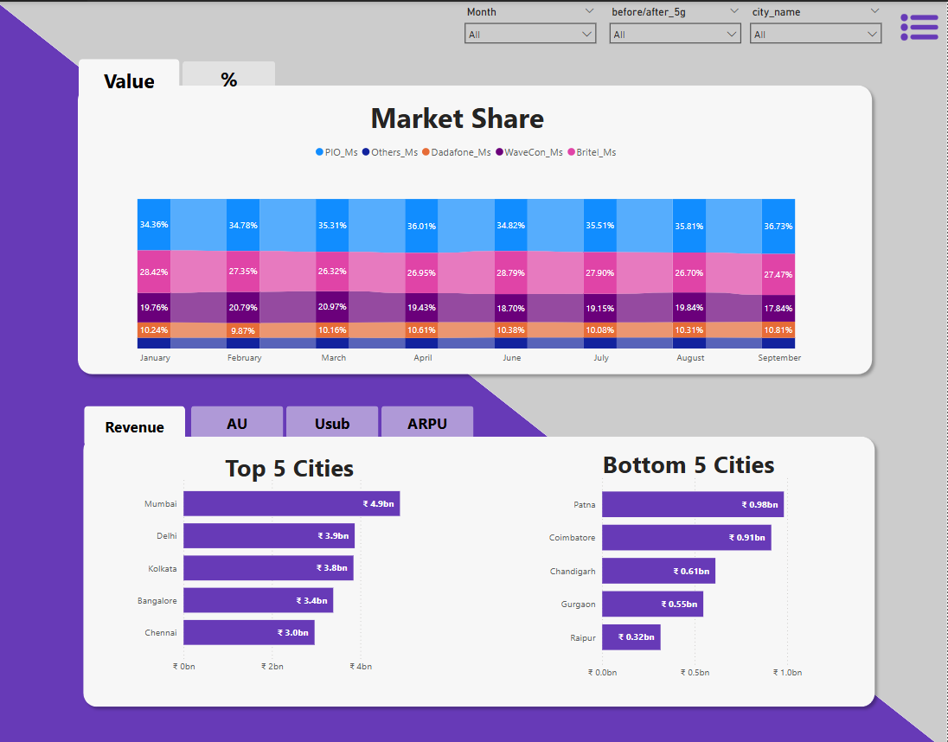

Slide 4
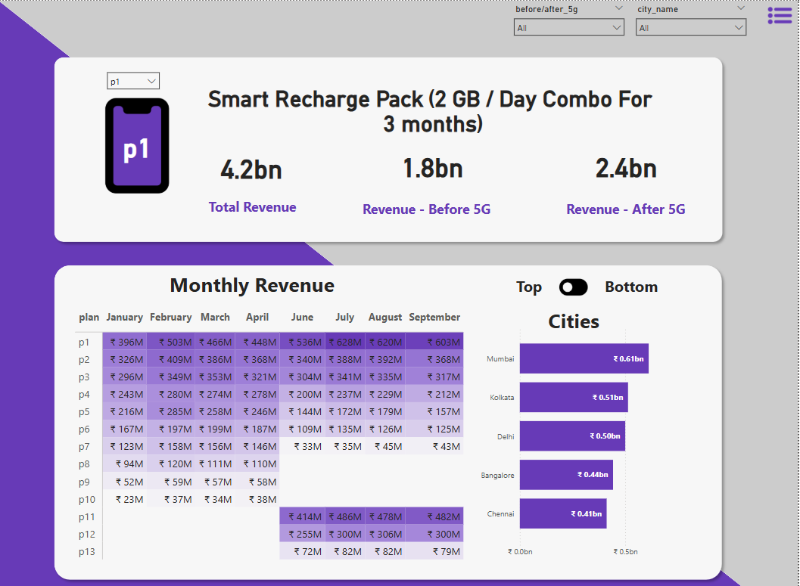

Slide 5
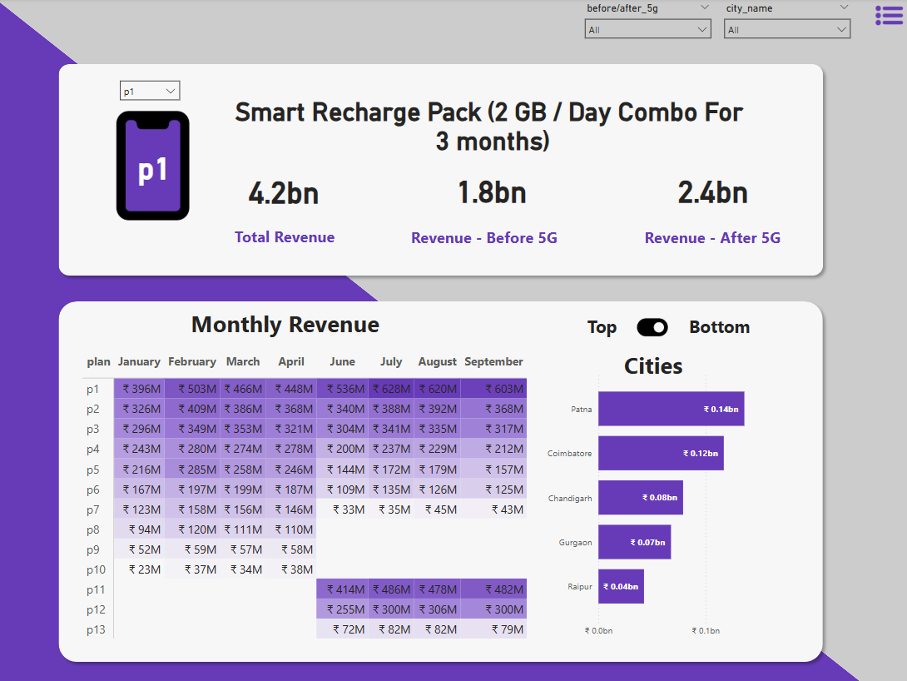

Slide 6
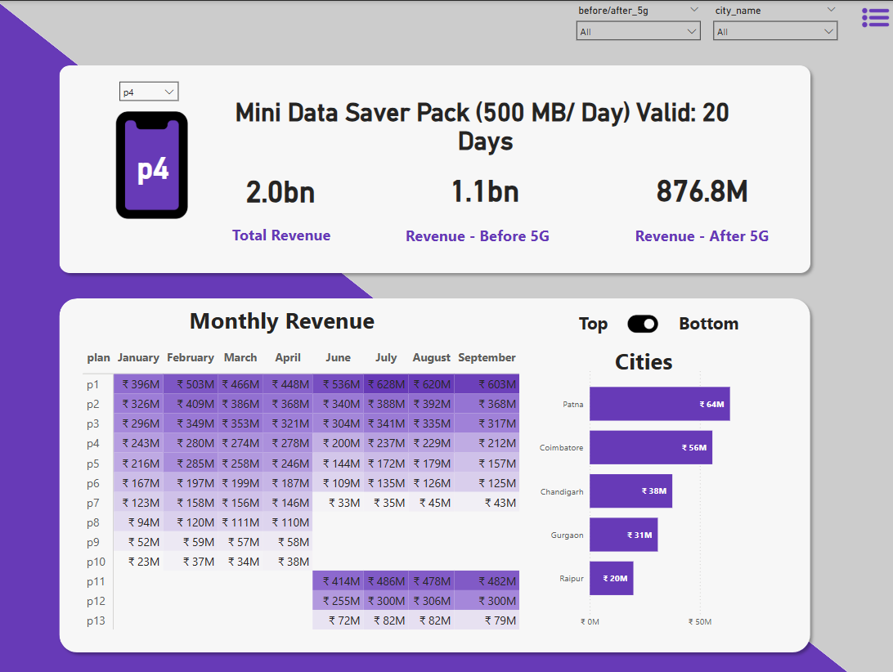

Slide 7
task is to analyze the dashboard and provide insights
What is the impact of the 5G launch on our revenue?
Which KPI is underperforming after the 5G launch?
After the 5G launch, which plans are performing well in terms of revenue?
Which plans are not performing well? Is there any plan affected largely by the 5G launch?
Should we continue or discontinue that plan?
Is there any plan that is discontinued after the 5G launch? What is the reason for it?

Slide 8
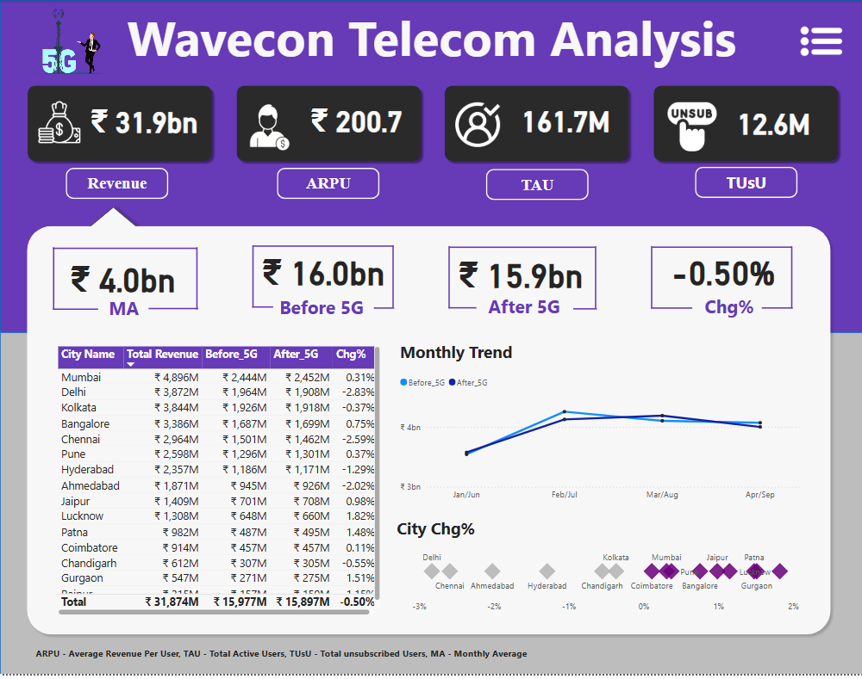
What is the impact of the 5G launch on our revenue?
Impact of 5G Launch on Revenue
The 5G launch had a negative impact on overall revenue:
Revenue decreased from ₹16.0bn (Before 5G) to ₹15.9bn (After 5G)
This represents a -0.50% decline in total revenue
The monthly average (MA) also dropped from ₹4.0bn to current levels

Slide 9
Which KPI is underperforming after the 5G launch?
Underperforming KPI After 5G Launch
Revenue is the primary underperforming KPI after the 5G launch, showing a 0.50% decline.
However, other metrics show mixed results:
ARPU (Average Revenue Per User): ₹200.7 M
TAU (Total Active Users): 161.7M
TUsU (Total Unsubscribed Users): 12.6M

Slide 10
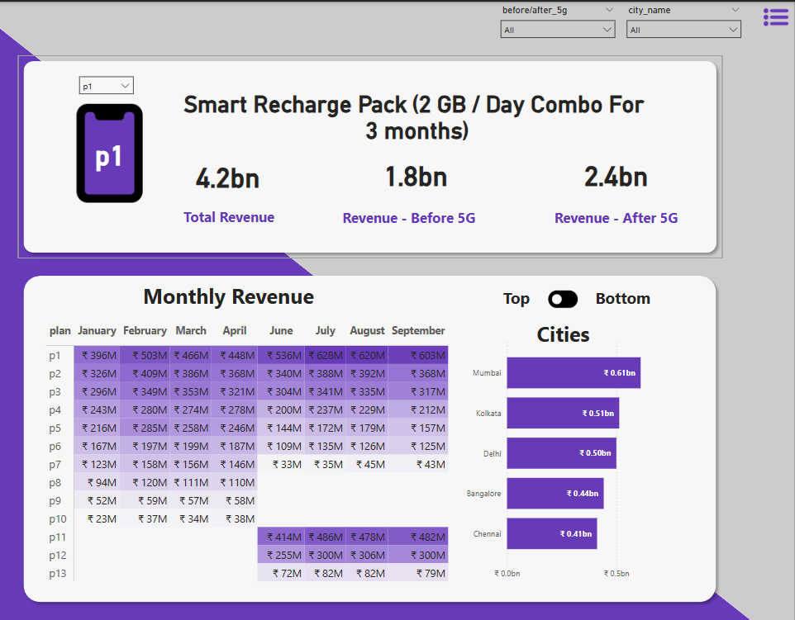
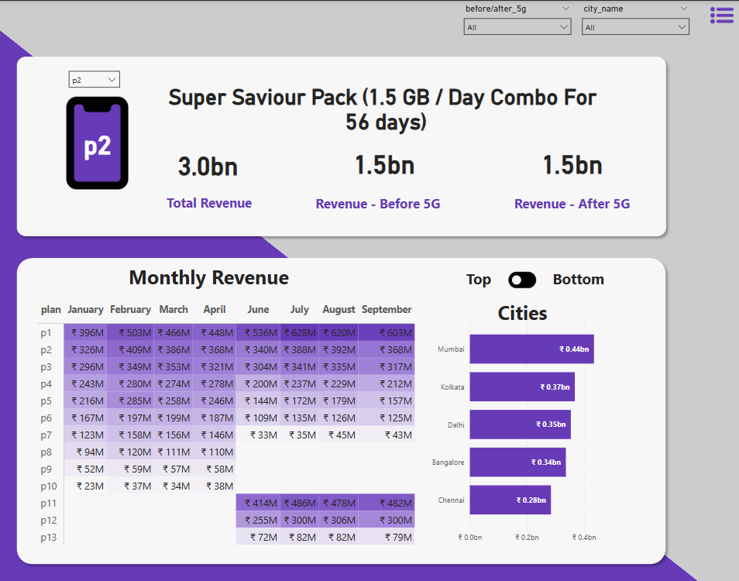
After the 5G launch, which plans are performing well in terms of revenue?
Plan Performance After 5G Launch. Well-Performing Plans:
p1 (Smart Recharge Pack) - Shows strong performance with ₹2.4bn revenue after 5G (vs ₹1.8bn before)
p2 (Super Saviour Pack) - Maintained stable revenue at ₹1.5bn after 5G

Slide 11

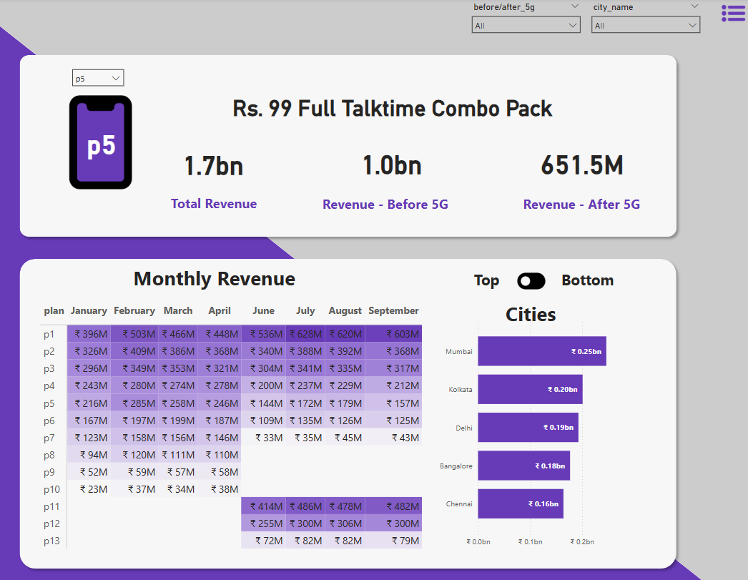
Which plans are not performing well? Is there any plan affected largely by the 5G launch?
Underperforming Plans:
p4 (Mini Data Saver Pack) - Revenue dropped significantly from ₹1.1bn to ₹876.8M
Higher-tier plans (p5-p13) - Showing declining revenue trends in the monthly data

Slide 12
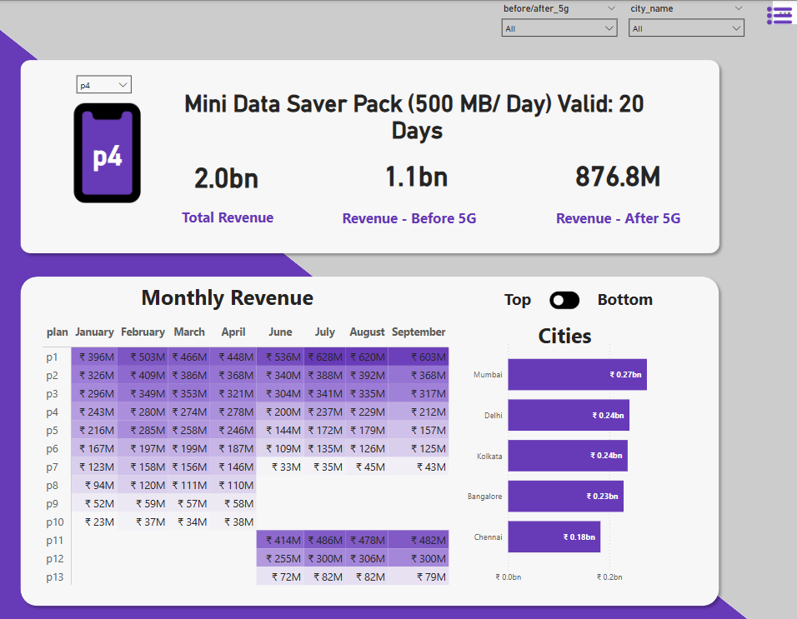
Should we continue or discontinue that plan?
Plan Most Affected by 5G Launch
Plan p4 (Mini Data Saver Pack) appears to be the most negatively affected:
Revenue dropped from ₹1.1bn (Before 5G) to ₹876.8M (After 5G)
This represents approximately a 20% decline
Recommendation: Consider discontinuing or restructuring this plan as it's clearly not competitive in the 5G era

Slide 13
Is there any plan that is discontinued after the 5G launch? What is the reason for it?
Discontinued Plans After 5G Launch
Looking at the monthly revenue data, plans p8, p9, and p10 appear to have been discontinued or significantly reduced after the 5G launch:
These plans show no revenue data in recent months (particularly p8-p10 in the monthly tables)
Likely reasons for discontinuation:
Low data allowances became obsolete with 5G's high-speed CapaBilities.
Customer migration to higher-value 5G-enabled.
Strategic focus on fewer, more profitable plan options.
Simplified portfolio to reduce complexity.

Slide 14
Key Recommendations:
Restructure or discontinue p4 due to poor post-5G performance
Focus marketing efforts on p1 and p2 which are performing well
Investigate the revenue decline to understand customer behavior changes
Consider introducing new 5G-specific plans to capitalize on the technology upgrade

Slide 15
Thank you

